Slide 1
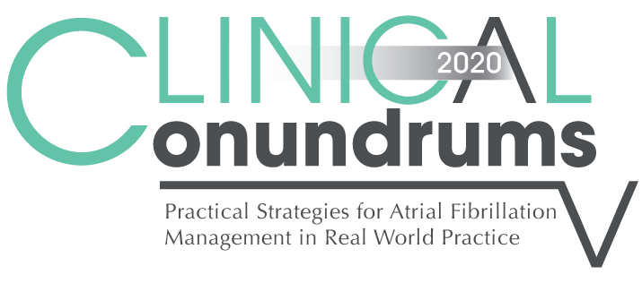



Case 5
CASE 5
Brett
Management of Antithrombotic Therapy in
Patients With AF and CAD

Slide 2

Learning Objectives
Upon completion of this activity, participants should be able to:
I
Recognize the high prevalence of CAD in AF patients and the need to balance the risks of recurrent coronary events, embolic stroke and bleeding when optimizing antithrombotic therapy in these patients
Select optimal antiplatelet and / or OAC medication in patients with:
AF and stable CAD
AF and recent PCI / stent placement
AF and recent ACS / with or without revascularization
AF and recent CABG
II
III
Determine the optimal duration of antiplatelet / OAC treatment in different AF + CAD settings

Slide 3


Background
Atrial fibrillation (AF) is the most common cardiac arrhythmia, with increasing prevalence among the elderly.
Approximately 20 to 30% of patients with AF also have concomitant coronary artery disease (CAD) and 5 to 10% of patients who undergo percutaneous coronary intervention (PCI) have AF.
?
A clinical conundrum arises when patients with AF on oral anticoagulation (OAC)
develop an acute coronary syndrome (ACS) and/or require PCI.
There is a significant unmet need for an oral antithrombotic strategy with an acceptable benefit/risk profile for treating patients with both AF and CAD.
Stent Thrombosis
Stroke
DAPT does not provide a large treatment effect in preventing
AF-related strokes.
DAPT
VKAs have not been shown to prevent stent thrombosis and are not indicated for secondary prevention following an ACS
OAC
Major Bleeding
Triple therapy significantly increases the risk of bleeding
ACS, acute coronary syndrome; AF, atrial fibrillation; CAD, coronary artery disease; DAPT, dual antiplatelet therapy; OAC, oral anticoagulation; PCI, percutaneous coronary intervention; VKA, vitamin K antagonist.
Lopes RD et al. Am Heart J. June 2018; 200:17-23 doi:10.1016/j.ahj.2018.03.001
Adapted from Lopes RD et al. Oral presentation at ACC Apr 2016; Chicago, IL, USA. Abstract number 695-15
Dewilde WJ et al. Lancet 2013;381:1107-1115
Notes:
Speaker Notes:

Slide 4
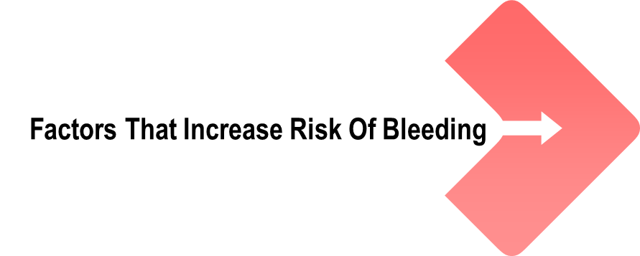

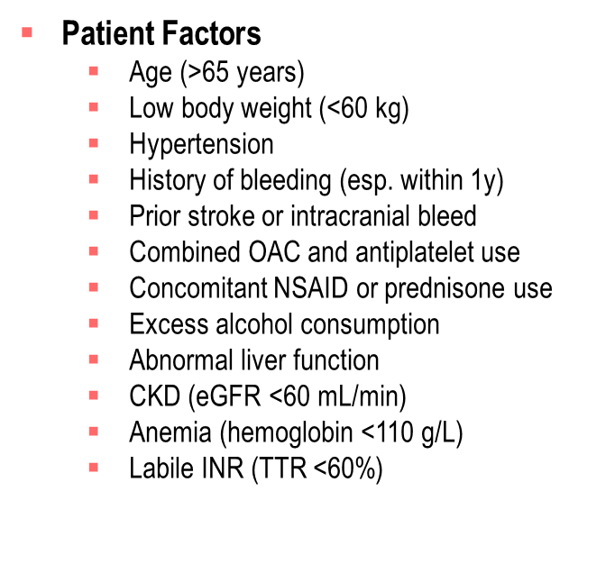
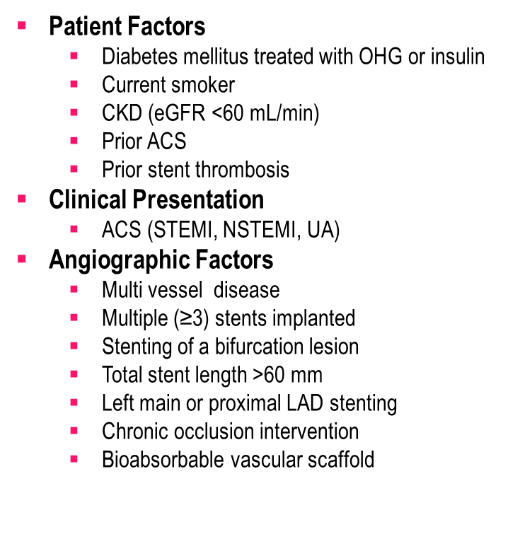
Background
Andrade JG et al. Can J Cardiol 2018;34:1371-1392
Notes:
Speaker Notes:
Risk factors associated with an increased mlf bleeding, and an increased risk of ischemic coronary outcomes (recurrent myocardial infarction, stent thrombosis). ACS, acute coronary syndrome; CKD, chronic kidney disease; eGFR, estimated glomerular filtration rate; INR, international normalized ratio; LAD, left anterior descending artery; NSAID, nonsteroidal anti-inflammatory drug; NSTEMI, non–ST-elevation myocardial infarction; OHG, oral hypoglycemic agents; STEMI, ST-elevation myocardial infarction; TTR, Time in Therapeutic Range; UA, unstable angina.

Slide 5

2018 Focused Update of the
CCS AF Guidelines
RECOMMENDATION
When an OAC is indicated in the presence of coronary or arterial vascular disease, we suggest a DOAC in preference to warfarin
(Weak Recommendation, Moderate-Quality Evidence)
Andrade JG et al. Can J Cardiol 2018;34:1371-1392
Notes:
Speaker Notes:
Key Message:
DOAC is now preferred in ALL AF+CAD settings where OAC is indicated
Values and Preferences:
The suggestion for use of a DOAC rather than warfarin places relatively greater weight on the ease of use of DOACs vs warfarin, as well as the data from randomized controlled trials of DOACs vs warfarin for NVAF (eg, equal or greater reduction of stroke, equal or greater reduction in all-cause mortality, equal or less major bleeding, less intracranial bleeding, and no net increase in CAD outcomes).

Slide 6
Case 5
Brett
72 years old
Brett is a retired accountant
He has longstanding hypertension and dyslipidemia
He quit smoking five years ago at the time of his myocardial infarction (STEMI)
He underwent primary successful PCI and stenting of his LAD at that time
He has since been active and asymptomatic from a cardiovascular standpoint
Paroxysmal AF was incidentally diagnosed one year ago
Notes:
Speaker Notes:
Risk factors associated with an increased mlf bleeding, and an increased risk of ischemic coronary outcomes (recurrent myocardial infarction, stent thrombosis). ACS, acute coronary syndrome; CKD, chronic kidney disease; eGFR, estimated glomerular filtration rate; INR, international normalized ratio; LAD, left anterior descending artery; NSAID, nonsteroidal anti-inflammatory drug; NSTEMI, non–ST-elevation myocardial infarction; OHG, oral hypoglycemic agents; STEMI, ST-elevation myocardial infarction; TTR, Time in Therapeutic Range; UA, unstable angina.

Slide 7



Case 5
Brett
72 years old
Notes:
Speaker Notes:
Risk factors associated with an increased mlf bleeding, and an increased risk of ischemic coronary outcomes (recurrent myocardial infarction, stent thrombosis). ACS, acute coronary syndrome; CKD, chronic kidney disease; eGFR, estimated glomerular filtration rate; INR, international normalized ratio; LAD, left anterior descending artery; NSAID, nonsteroidal anti-inflammatory drug; NSTEMI, non–ST-elevation myocardial infarction; OHG, oral hypoglycemic agents; STEMI, ST-elevation myocardial infarction; TTR, Time in Therapeutic Range; UA, unstable angina.

Slide 8
Case 5
Brett is taking apixaban but wonders why he is no longer on ASA for his CAD (since his brother is prescribed ASA for his CAD…)
Notes:
Speaker Notes:

Slide 9

What is the role of ASA and a DOAC in the setting of AF and stable CAD ?
Select from one or more of the available options
DOAC alone is appropriate in AF patients with stable CAD
Adding ASA to a DOAC in stable CAD provides no additional benefit but greatly increases the risk of bleeding
ASA alone is appropriate in AF patients at low risk of embolic stroke
All are correct
Notes:
Speaker Notes:
Correct Answer: 4 (All are correct)
Make the point about the heightened risk of bleeding when ASA added to a DOAC . PCPs should specifically reconsider the ongoing need for ASA in all of their DOAC treated patients..!

Slide 10

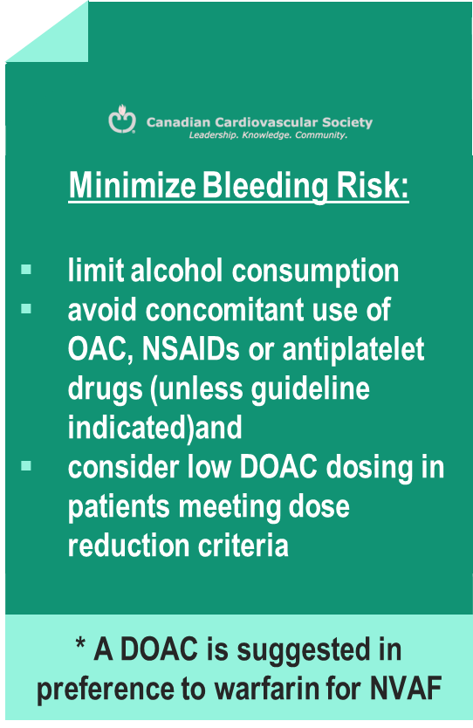
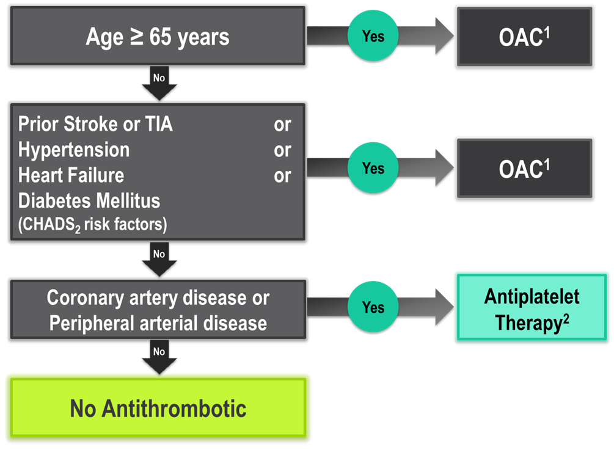
The “CCS Algorithm” (CHADS-65)
for OAC Therapy in AF
Andrade JG et al. Can J Cardiol 2018;34:1371-1392
CCS AF Guidelines. Can J Cardiol. 2016; 32: 1170-1185
¹ A DOAC is preferred over warfarin in non-valvular AF
² Therapeutic options include single antiplatelet therapy (ASA 81-100 mg daily) alone; or in combination with either a second antiplatelet agent (e.g. clopidogrel 75 mg daily or ticagrelor 60 mg BID), or an antithrombotic agent (rivaroxaban 2.5 mg BID)
Notes:
Speaker Notes:
The current threshold risk warranting long-term OAC therapy in AF in Canada is set at about 1.5%/yr.
The “CCS Algorithm” is a simple way of identifying AF patients whose risk is below that threshold (i.e. age ≤ 64 and CHADS₂ = 0)
Low embolic stroke / SE risk AF patients require no OAC therapy but may need low dose ASA to prevent ischemic complications (i.e. MI or ischemic stroke) if they have vascular disease (i.e. CAD, PAD, aortopathy or carotid atherosclerosis).
Unlike in Europe and the US where the CHADSVASC score is used to determine long-term OAC eligibility in AF, the CCS Canadian AF Guidelines have not accepted vascular disease alone as an indication for OAC in AF. It is felt that vascular disease alone in younger patients aged < 65 does not carry a stroke/SE risk of >1.5%/yr and that such patients benefit more from long-term ASA use to prevent ischemic complications.

Slide 11
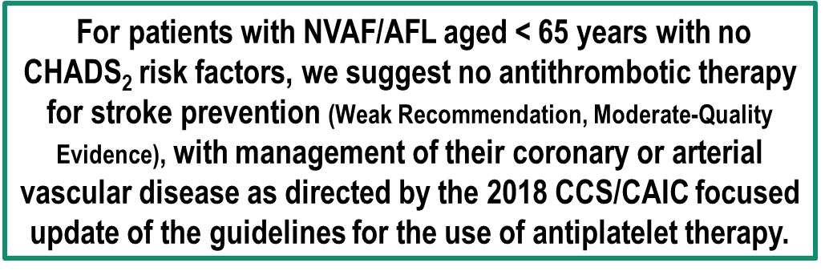
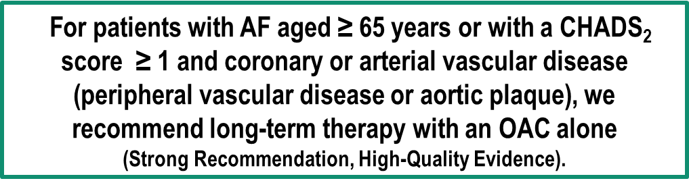
2018 Focused Update of the
CCS AF Guidelines
RECOMMENDATIONS
ASA alone is appropriate in AF patients at low risk of embolic stroke (< 1.5%/yr)
DOAC alone is appropriate in AF patients with stable CAD when anticoagulation is indicated (risk of embolic stroke ≥ 1.5 %/yr)
Andrade JG et al. Can J Cardiol 2018;34:1371-1392
Notes:
Speaker Notes:
Values and Preferences:
For patients with AF and stable coronary or arterial vascular disease, the CCS AF Guidelines Committee believed that routine use of combination therapy (an OAC with a single antiplatelet agent) was not justified because of the increased risk of bleeding without a significant reduction in ischemic coronary and cerebrovascular thrombotic events.

Slide 12
Case 5
Brett had an elective PCI and a stent one month ago and was started on “dual pathway” therapy with clopidogrel + apixaban
Notes:
Speaker Notes:

Slide 13
How long will you keep Brett on this therapy?
Select from one or more of the available options
1 month
3 months
6 months
1 year
As long as the interventional cardiologist dictates
Notes:
Speaker Notes:
Correct Answer: 5. As long as the interventional cardiologist dictates
The purpose of adding a P2Y12 antiplatelet agent such as clopidogrel +/- ASA to a DOAC following PCI with stent implantation is to reduce the risk of stent thrombosis while the metal struts of the stent are covered by vascular endothelial cells thus eliminating blood-metal contact.
The length of time needed for complete endothelialisation of the stent will vary with stent type (newer generation drug eluting stents require less time, bare metal stents require least time but are seldom used these days…) as well as procedural factors (number of stents deployed, number of centimeters of coronary artery stented, effectiveness of strut apposition to the vessel wall, left main or complex bifurcation stents etc etc).
Accordingly, the specific recommendations of the interventional cardiologist should be carefully followed in each case in order to optimize the duration of dual pathway therapy and minimize both the risk of stent thrombosis as well as bleeding complications.

Slide 14
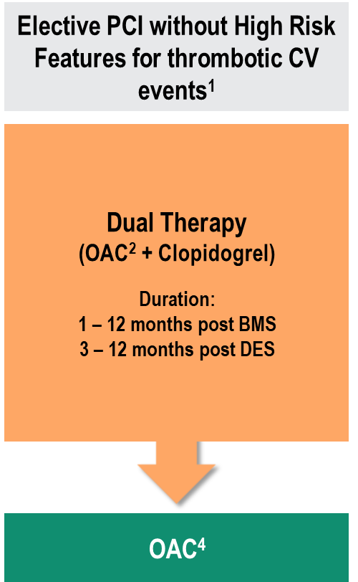
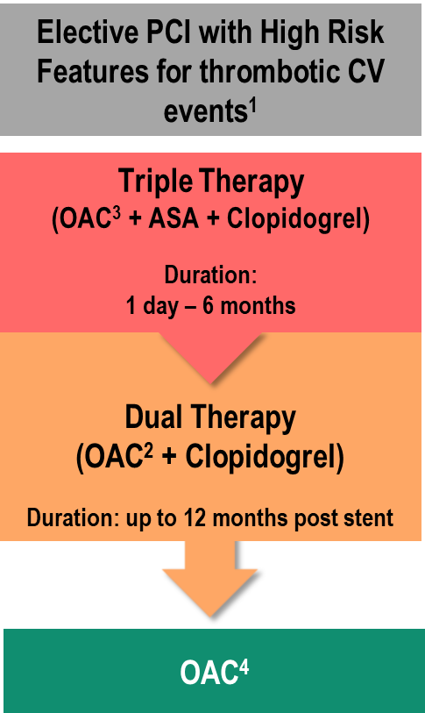
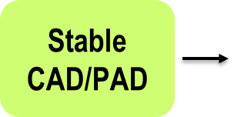
AF Patients with Coronary or Peripheral Arterial Disease and an Indication for OAC*
2018 Focused Update of the CCS AF Guidelines
* aged ≥ 65 years or with a CHADS₂ score ≥ 1
Andrade JG et al. Can J Cardiol 2018;34:1371-1392
Notes:
Speaker Notes:
This is a slide with animation revealing column two and the approach to the high-risk PCI patient (defined under 1. below.
The PCP would not need to know the details here, only to follow the interventional cardiologist's specific recommendation.
Management of antithrombotic therapy in patients with atrial fibrillation (AF) and coronary artery disease (CAD)/peripheral artery disease (PAD). ACS, acute coronary syndrome; ASA, acetylsalicylic acid; BID, twice per day; BMS, bare metal stent; BVS, bioabsorbable vascular scaffold; CCS, Canadian Cardiovascular Society; CHADS₂, Congestive Heart Failure, Hypertension, Age, Diabetes, Stroke/Transient Ischemic Attack; CrCl, creatinine clearance; CV, cardiovascular; DES, drug-eluting stent; eGFR, estimated glomerular filtration rate; INR, international normalized ratio; DOAC, non-vitamin K antagonist oral anticoagulant; OAC, oral anticoagulant; PCI, percutaneous coronary intervention; PO, orally.
A PCI is considered high-risk based on clinical and angiographic features such as: diabetes mellitus, current smoker, chronic renal dysfunction (eGFR < 60 mL/min), prior ACS, prior stent thrombosis, multi-vessel disease, multiple stents implanted, complex bifurcation lesion, total stent length > 60 mm, chronic total occlusion intervention, or bioabsorbable vascular scaffold (BVS) implantation.
Regimens evaluated in this context include: warfarin daily, rivaroxaban 15 mg PO daily (10 mg in patients with CrCl 30-50 mL/min), dabigatran 110 mg or 150 mg PO BID. A DOAC is preferred over warfarin, however if warfarin is to be used the lower end of the recommended INR target range is preferred. All patients should receive a loading dose of ASA 160 mg at the time of PCI (if previously ASA naïve).
Regimens evaluated in this context include: warfarin daily, or rivaroxaban 2.5 mg PO BID. A DOAC is preferred over warfarin, however if warfarin is to be used the recommended INR target is 2.0-2.5. All patients should receive a loading dose of ASA 160 mg at the time of PCI (if previously ASA naïve). Thereafter, ASA may be discontinued as early as the day following PCI or it can be continued longer term (e.g. 1 to 6 months after PCI). The timing of when to discontinue ASA will depend on the individual patient’s ischemic and bleeding risk.
The dose of OAC beyond year after PCI should be the standard stroke prevention dose. Single antiplatelet therapy with ASA or clopidogrel may be added to OAC if high-risk clinical or angiographic features or ischemic events and low risk of bleeding

Slide 15
Case 5
What if Brett was admitted with ACS and was started on “Dual Antiplatelet” therapy in addition to his DOAC
Notes:
Speaker Notes:

Slide 16
How long would you keep Brett on dual antiplatelet therapy (DAPT) post ACS?
Select from one or more of the available options
1 day
6 months
Forever
Depends on whether he had a PCI / stent
Depends on his ischemic vs. bleeding risk
Notes:
Speaker Notes:
CORRECT ANSWER: All answers EXCEPT “Forever” may be correct here. The goal is to minimize the duration of DAPT (as little as 1 day in some, up to 6 months in others depending on relative ischemic and bleeding risk. The approach is individualized and determined by the interventional cardiologist at the time of the procedure. Recommendations in the cath report are therefore to be followed.
A significant number of patients who suffer an ACS are treated with medical therapy alone (e.g. late presentation, advanced age, multiple co-morbidities). In the absence of AF, these patients are given DAPT for 12 months or longer (PEGASUS study). With concomitant AF, single antiplatelet therapy with clopidogrel along with a DOAC is recommended to optimize balance between ischemic and bleeding risk.
Although DAPT in ACS with the two newer P2Y12 antiplatelet agents (ticagrelor and prasugrel) was more effective than with clopidogrel at preventing ischemic complications (PLATO and TRITON-TIMI 38 studies), this was at the expense of slightly greater bleeding. Accordingly clopidogrel is generally preferred over ticagrelor or prasugrel in ACS with AF requiring concomitant DOAC therapy to minimize bleeding risk.
The purpose of adding a P2Y12 antiplatelet agent such as clopidogrel +/- ASA to a DOAC following PCI with stent implantation is to reduce the risk of stent thrombosis while the metal struts of the stent are covered by vascular endothelial cells thus eliminating blood-metal contact.
The length of time needed for complete endothelialisation of the stent will vary with stent type (newer generation drug eluting stents require less time, bare metal stents require least time but are seldom used these days…) as well as procedural factors (number of stents deployed, number of centimeters of coronary artery stented, effectiveness of strut apposition to the vessel wall, left main or complex bifurcation stents etc etc).
Accordingly, the specific recommendations of the interventional cardiologist should be carefully followed in each case in order to optimize the duration of dual pathway therapy and minimize both the risk of stent thrombosis as well as bleeding complications.

Slide 17
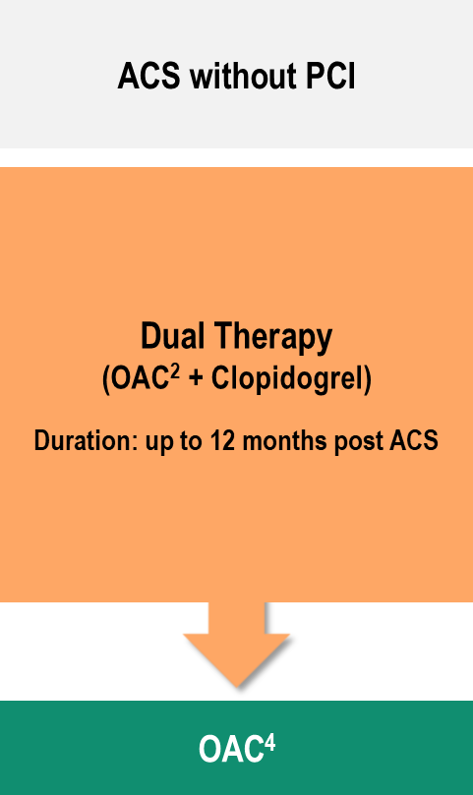
AF Patients with Coronary or Peripheral Arterial Disease and an Indication for OAC*
2018 Focused Update of the CCS AF Guidelines
* aged ≥ 65 years or with a CHADS₂ score ≥ 1
Andrade JG et al. Can J Cardiol 2018;34:1371-1392
Notes:
Speaker Notes:
This is a slide with animation revealing the last column (column 3) and the approach to the ACS without PCI patient
Management of antithrombotic therapy in patients with atrial fibrillation (AF) and coronary artery disease (CAD)/peripheral artery disease (PAD). ACS, acute coronary syndrome; ASA, acetylsalicylic acid; BID, twice per day; BMS, bare metal stent; BVS, bioabsorbable vascular scaffold; CCS, Canadian Cardiovascular Society; CHADS₂, Congestive Heart Failure, Hypertension, Age, Diabetes, Stroke/Transient Ischemic Attack; CrCl, creatinine clearance; CV, cardiovascular; DES, drug-eluting stent; eGFR, estimated glomerular filtration rate; INR, international normalized ratio; DOAC, non-vitamin K antagonist oral anticoagulant; OAC, oral anticoagulant; PCI, percutaneous coronary intervention; PO, orally.
A PCI is considered high-risk based on clinical and angiographic features such as: diabetes mellitus, current smoker, chronic renal dysfunction (eGFR < 60 mL/min), prior ACS, prior stent thrombosis, multi-vessel disease, multiple stents implanted, complex bifurcation lesion, total stent length > 60 mm, chronic total occlusion intervention, or bioabsorbable vascular scaffold (BVS) implantation.
Regimens evaluated in this context include: warfarin daily, rivaroxaban 15 mg PO daily (10 mg in patients with CrCl 30-50 mL/min), dabigatran 110 mg or 150 mg PO BID. A DOAC is preferred over warfarin, however if warfarin is to be used the lower end of the recommended INR target range is preferred. All patients should receive a loading dose of ASA 160 mg at the time of PCI (if previously ASA naïve).
Regimens evaluated in this context include: warfarin daily, or rivaroxaban 2.5 mg PO BID. A DOAC is preferred over warfarin, however if warfarin is to be used the recommended INR target is 2.0-2.5. All patients should receive a loading dose of ASA 160 mg at the time of PCI (if previously ASA naïve). Thereafter, ASA may be discontinued as early as the day following PCI or it can be continued longer term (e.g. 1 to 6 months after PCI). The timing of when to discontinue ASA will depend on the individual patient’s ischemic and bleeding risk.
The dose of OAC beyond year after PCI should be the standard stroke prevention dose. Single antiplatelet therapy with ASA or clopidogrel may be added to OAC if high-risk clinical or angiographic features or ischemic events and low risk of bleeding

Slide 18
Effect of Adding Double Antiplatelet therapy (DAPT) to Warfarin or a DOAC
Warfarin
dabi-110
dabi-150
6.3
5.4
5.5
4.6
4.3
Major Bleeding (% / Year)
3.8
2.8
2.6
2.2
No AP
SAP
DAP
No AP
SAP
DAP
No AP
SAP
DAP
Active A Writing Group. N Engl J Med 2009;360:2066-78
Dans Al et al. Circulation 2013;127:634-40
Notes:
Speaker Notes:

Slide 19
Number of Strategies in the ACS Patient with Atrial Fibrillation
ASA Dose: None Low High |  |  |  |  | 3 | 1+8 = 9 ASA
ASA Duration (months): | 1 | 3 | 6 | 12 | 4
ADPri: None Clopidogrel Prasugrel Ticagrelor |  |  |  |  | 4 | 1+12 = 13 ADPri
ADPri Duration (months): | 1 | 3 | 6 | 12 | 4
OAC: None Warfarin Dabigatran Rivaroxaban |  |  |  |  |  | 1+10 = 11 OAC
Apixaban Edoxaban |  |  |  |  | 5
OAC INR/Dose: Low High |  |  |  |  | 2
Permutations of Single, Dual, or Triple Therapy as Early Initial Therapy following ACS: 9 x 13 x 11 = 1,287
Permutations of Single or Dual Therapy Late After Early (0,1,3,6 months) following ACS: 1,287
Total Permutations throughout 1 year: 1,656,369
Adapted from Gibson CM. J Am Coll Cardiol 2017; 69:172-75.
Notes:
Speaker Notes:

Slide 20
The AUGUSTUS Trial
Background
The optimal antithrombotic for patients with AF who have an ACS or require PCI s unclear.¹
Prior studies were designed to identify strategies to reduce the bleeding associated with triple antithrombotic therapy.¹
WOEST (N = 573): less bleeding AND fewer ischemic events without ASA compared with VKA + DAPT.²
PIONEER AF-PCI (N = 2124): less bleeding with two reduced-dose rivaroxaban regimens compared with VKA + DAPT.³
RE-DUAL PCI (N = 2725): less bleeding with two standard-dose dabigatran regimens, without ASA, compared with VKA + DAPT.⁴
Limited data with apixaban in patients with AF requiring DAPT.
Data on the independent effects of ASA were needed.
ACS: acute coronary syndrome ; PCI: percutaneous coronary intervention; VKA: vitamin K antagonist; DAPT: dual antiplatelet therapy
Lopes RD et al. Oral presentation at ACC 2019, 16-18 March, New Orleans, LA, USA, late breaking clinical trial 405-08.
Dewilde WJ et al. Lancet 2013;381:1107-1115.
Gibson CM et al. N Engl J. Med. 2016;375:2423-2434.
Cannon CP et al. N Engl J. Med. 2017;377:1513-1524
Notes:
Speaker Notes:
Oral anticoagulation is necessary in AF patients to prevent stroke
Dual antiplatelet therapy is necessary in ACS/PCI patients to prevent recurrent ischemic events and stent thrombosis

Slide 21
The AUGUSTUS Trial
Design
INCLUSION
Atrial fibrillation (prior, persistent, > 6 hr).
Physician decision for OAC.
Acute coronary syndrome or PCI.
Planned P2Y₁₂ inhibitor for ≥ 6 months.
EXCLUSION
Contraindication to DAPT.
Other reason for VKA (prosthetic valve, moderate/severe mitral stenosis).
Randomize
N = 4600
patients
Apixaban 5 mg BID
Apixaban 2.5 mg BID in selected patients
Open Label
VKA
(INR 2 to 3)
Aspirin for all on the day of ACS or PCI
Aspirin versus placebo after randomization
Double
Blind
Median time from ACS/PCI to randomization:
6 (3, 10) days
Aspirin
Placebo
Aspirin
Double
Blind
Placebo
Primary outcome: ISTH major/CRNM bleeding
Secondary outcome(s): death/hospitalization, death/ischemic events
ACS, acute coronary syndrome; BID, twice daily; CRNM, clinically relevant non-major; DAPT, dual antiplatelet therapy; INR, international normalized ratio; ISTH, International Society on Thrombosis and Haemostasis; OAC, oral anticoagulant; PCI, percutaneous coronary intervention; VKA, vitamin K antagonist.
Lopes RD et al. DOI: 10.1056/NEJMoa1817083
Notes:
Speaker Notes:
BACKGROUND
Appropriate antithrombotic regimens for patients with atrial fibrillation who have an acute coronary syndrome or have undergone percutaneous coronary intervention (PCI) are unclear.
METHODS
In an international trial with a two-by-two factorial design, we randomly assigned patients with atrial fibrillation who had an acute coronary syndrome or had undergone PCI and were planning to take a P2Y12 inhibitor to receive apixaban or a vitamin K antagonist and to receive aspirin or matching placebo for 6 months. The primary outcome was major or clinically relevant nonmajor bleeding. Secondary outcomes included death or hospitalization and a composite of ischemic events.
RESULTS
Enrollment included 4614 patients from 33 countries. There were no significant interactions between the two randomization factors on the primary or secondary outcomes. Major or clinically relevant nonmajor bleeding was noted in 10.5% of the patients receiving apixaban, as compared with 14.7% of those receiving a vitamin K antagonist (hazard ratio, 0.69; 95% confidence interval [CI], 0.58 to 0.81; P<0.001 for both noninferiority and superiority), and in 16.1% of the patients receiving aspirin, as compared with 9.0% of those receiving placebo (hazard ratio, 1.89; 95% CI, 1.59 to 2.24; P<0.001). Patients in the apixaban group had a lower incidence of death or hospitalization than those in the vitamin K antagonist group (23.5% vs. 27.4%; hazard ratio, 0.83; 95% CI, 0.74 to 0.93; P = 0.002) and a similar incidence of ischemic events. Patients in the aspirin group had an incidence of death or hospitalization and of ischemic events that was similar to that in the placebo group.
CONCLUSIONS
In patients with atrial fibrillation and a recent acute coronary syndrome or PCI treated with a P2Y12 inhibitor, an antithrombotic regimen that included apixaban, without aspirin, resulted in less bleeding and fewer hospitalizations without significant differences in the incidence of ischemic events than regimens that included a vitamin K antagonist, aspirin, or both. (Funded by Bristol-Myers Squibb and Pfizer; AUGUSTUS ClinicalTrials.gov number, NCT02415400.)

Slide 22
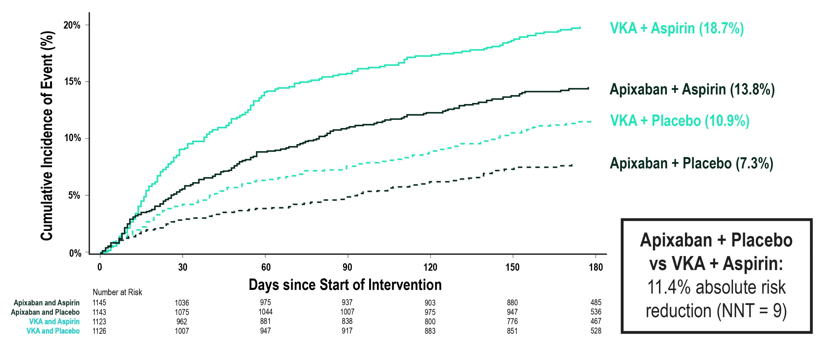
The AUGUSTUS Trial
Major/CRNM Bleeding
CRNM, clinical relevant non-major; NNT, number needed to treat; VKA, vitamin K antagonist.
Lopes RD et al. DOI: 10.1056/NEJMoa1817083
Notes:
Speaker Notes:
Results showed that in patients receiving a P2Y12 inhibitor with or without aspirin (antiplatelet therapies), the proportion of patients with major or clinically relevant non-major (CRNM) bleeding at six months was significantly lower for those treated with apixaban compared to those treated with a VKA (10.5% vs. 14.7%, respectively; hazard ratio [HR]: 0.69, 95% confidence interval [CI]: 0.58-0.81; p-superiority<0.001).

Slide 23
The ENTRUST-AF-PCI Trial Design
INCLUSION
OAC indication for AF at least 12 months
Successful PCI with stent placement (goal of at least 25% ACS)
Randomize
From between 4 hrs post sheath removal to 5 days post PCI
N = 1,506 patients
KEY EXCLUSION
Uncontrolled active bleeding including ISTH major and CRMN bleeding
Lesion/condition considered to be significant risk for major bleeding
Critically ill or hemodynamically unstable subjects
Edoxaban 60 mg OD*
+
P2Y12 inhibitor**
VKA (INR 2-3)+
P2Y₁₂ inhibitor**+
ASA 1-12 months***
Primary outcome: ISTH major or CRNM bleeding within 12 months
AF, atrial fibrillation; ACS, acute coronary syndrome; ASA, acetylsalicylic acid; BID, twice daily; CAD, coronary artery disease; CHA₂DS₂₋VASc, Congestive Heart failure, Hypertension, Age (2 points if over 75), Diabetes, Stroke/transient ischemic attack, Vascular disease, Age (1 point if between 65 and 74), Sex (1 point if female); CrCl, creatinine clearance; CRNMB: clinically relevant non-major bleeding; HAS-BLED, Hospitalization Abnormal renal and liver function, Stroke, Bleeding, Labile INR, Elderly, Drugs or alcohol; INR, international normalized ratio; ISTH, international Society for Thrombosis and Haematology; OAC, oral anticoagulant; PCI, percutaneous coronary intervention; VKA, vitamin K antagonist
Vranckx P, et al. Lancet. 2019;394(10206):1335-1343.
Notes:
Speaker Notes:

Slide 24
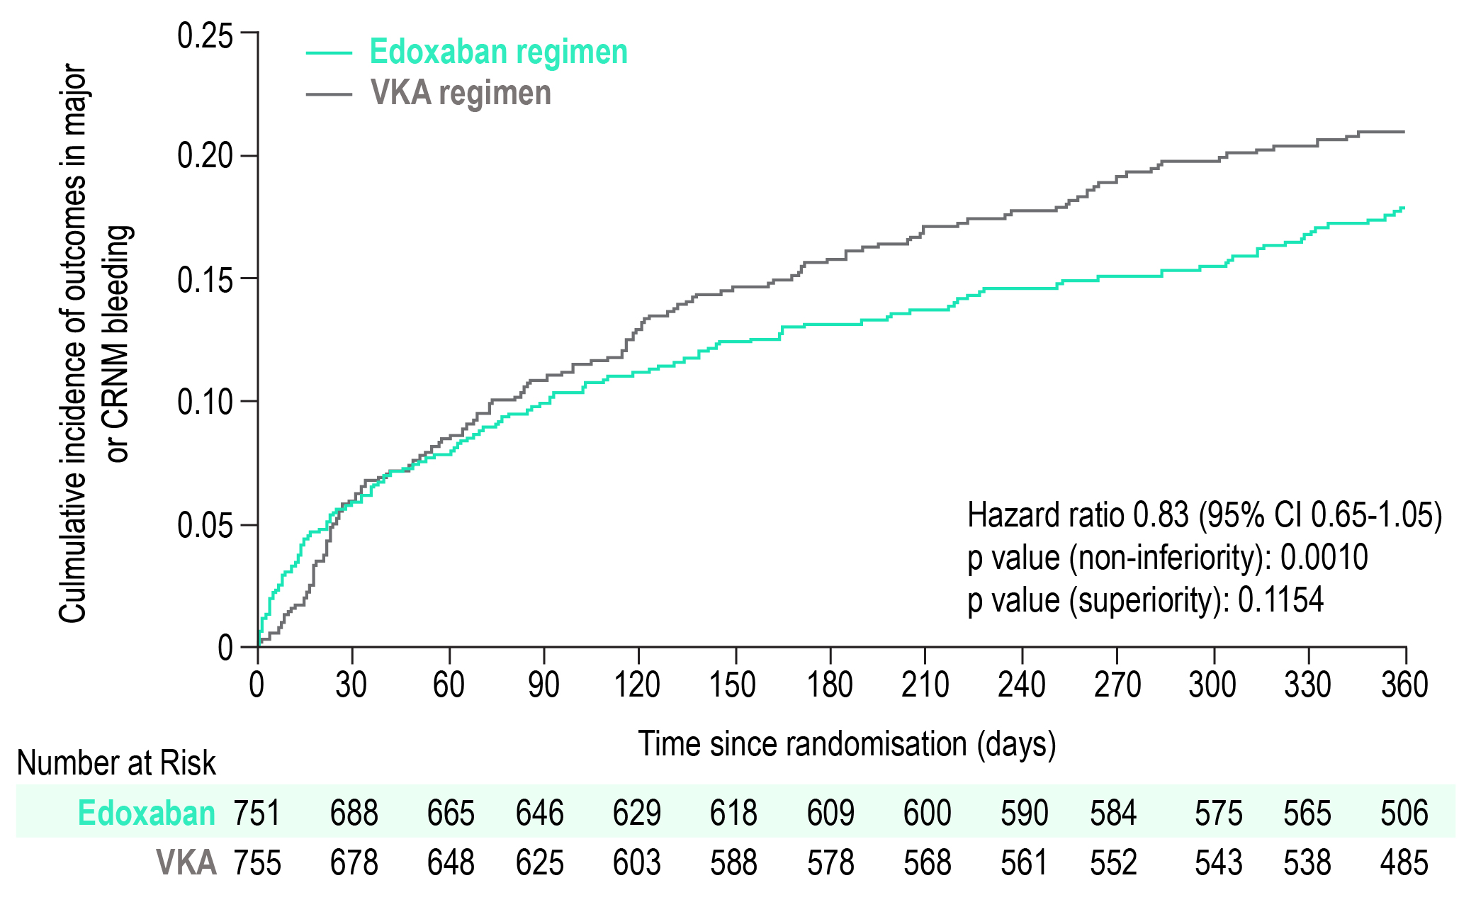
The ENTRUST-AF-PCI Trial Major/CRNM Bleeding
CRMN, clinically relevant non-major; VKA, vitamin K antagonist
Vranckx P, et al. Lancet. 2019;394(10206):1335-1343.
Notes:
Speaker Notes:

Slide 25
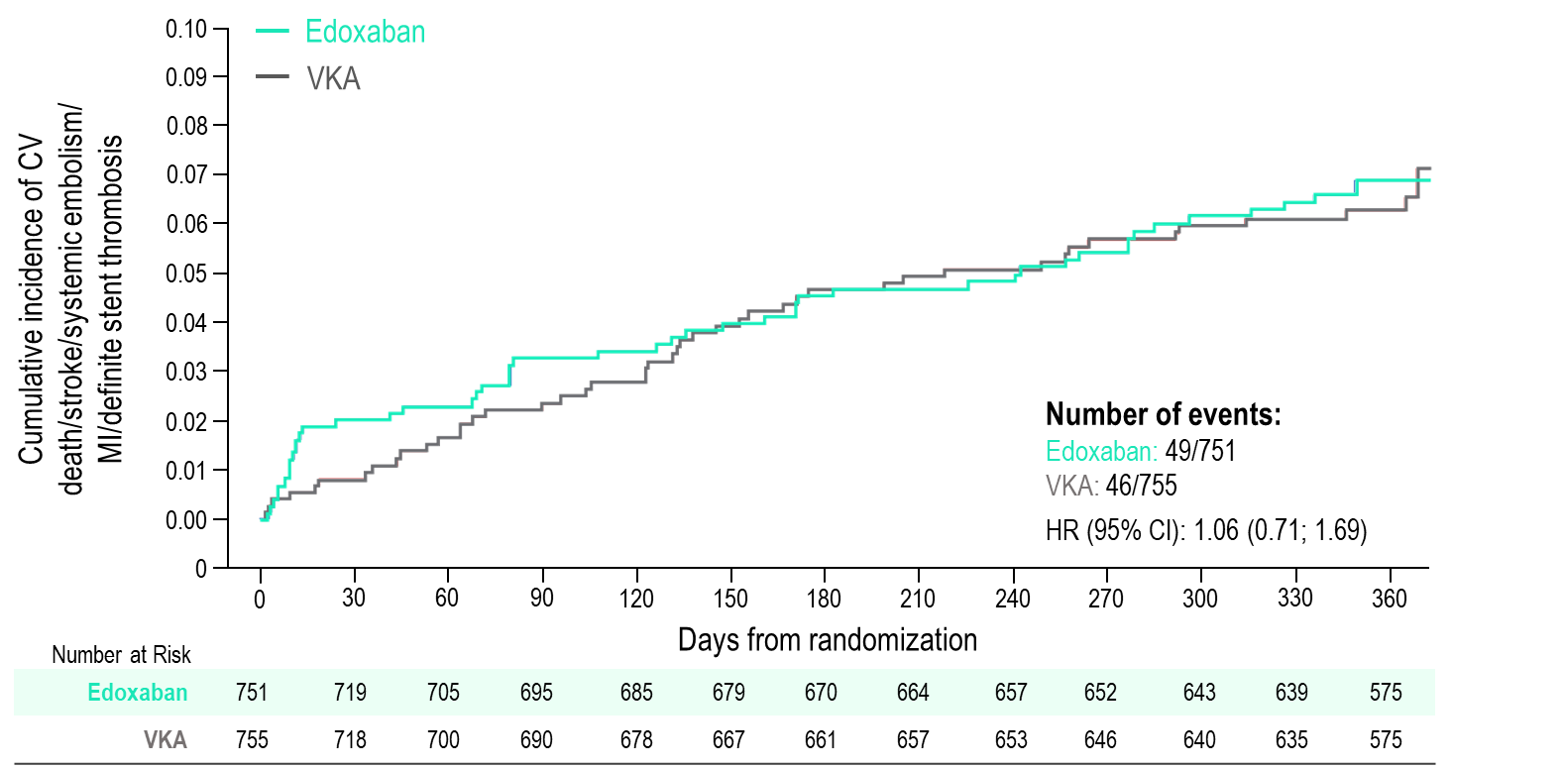
The ENTRUST-AF-PCI Trial
“…a very early numerical increase in ischaemic events (myocardial infarction, stent thrombosis, and cardiovascular death) was noted in patients without aspirin.”
Vranckx et al Lancet 2019;394:1335–43
Notes:
Speaker Notes:
Lower ICH (0.4% vs. 0.8%), fatal bleeding (1 vs. 7)
Higher MI (3.9% vs. 3.0%),
Definite stent thrombosis (1.2% vs. 0.9%), Death (6.7% vs. 5.4%)

Slide 26
Meta-analysis:
Comparative DOAC AF-CAD Trials
ISTH Major or Clinically Relevant Non-Major Bleeding
Study or Subgroup | NOAC DAT |  | VKA DAT |  | Weight |  | Risk Ratio M-H, Random, 95% CI |  | Risk Ratio M-H, Random, 95% CI
 | Events | Total | Events | Total
AUGUSTUS | 84 | 1,143 | 210 | 1,123 | 23.7% |  | 0.39 (0.31, 0.50)
ENTRUST AF-PCI | 128 | 751 | 152 | 755 | 24.7% |  | 0.85 (0.68, 1.05)
PIONEER AF-PCI | 117 | 696 | 178 | 697 | 24.8% |  | 0.66 (0.53, 0.81)
RE-DUAL PCI | 305 | 1,744 | 264 | 981 | 26.8% |  | 0.65 (0.56, 0.75)
Total (95% CI) |  | 4,334 |  | 3,556 | 100.0% |  | 0.62 (0.47, 0.81)
Total events | 634 |  | 804
Heterogeneity: Tau² = 0.07; CHi² = 22.84, df = 3 (P < 0.0001); I² = 87% Test for overall effect: Z = 3.47 (P = 0.0005)
0
0.1
1
10
100
Favours DOAC DAT
Favours VKA TAT
Stroke
Study or Subgroup | NOAC DAT |  | VKA DAT |  | Weight |  | Risk Ratio M-H, Random, 95% CI |  | Risk Ratio M-H, Random, 95% CI
 | Events | Total | Events | Total
AUGUSTUS | 84 | 1,143 | 210 | 1,123 | 23.7% |  | 0.39 (0.31, 0.50)
ENTRUST AF-PCI | 128 | 751 | 152 | 755 | 24.7% |  | 0.85 (0.68, 1.05)
PIONEER AF-PCI | 117 | 696 | 178 | 697 | 24.8% |  | 0.66 (0.53, 0.81)
RE-DUAL PCI | 305 | 1,744 | 264 | 981 | 26.8% |  | 0.65 (0.56, 0.75)
Total (95% CI) |  | 4,334 |  | 3,556 | 100.0% |  | 0.62 (0.47, 0.81)
Total events | 634 |  | 804
Heterogeneity: Tau² = 0.07; CHi² = 22.84, df = 3 (P < 0.0001); I² = 87% Test for overall effect: Z = 3.47 (P = 0.0005)
0
0.1
1
10
100
Favours DOAC DAT
Favours TAT
Vranckx et al Lancet 2019;394:1335–43
Notes:
Speaker Notes:

Slide 27
Implications for Aspirin
Clinical decision making should continue to be based on a balanced assessment of 3 competing risks:
Cardioembolic stroke, coronary ischemic events, and bleeding
Assessment should include:
Demographic and clinical variables
Clinical setting (i.e., acute vs. elective)
Angiographic complexity
Low risk of thrombotic events or high risk of bleeding → early omission of aspirin
Complex, multivessel PCI or high-risk ACS → greater duration of aspirin
Mehta SR. N Engl J Med 2019;380:1580-81.
Notes:
Speaker Notes:

Slide 28
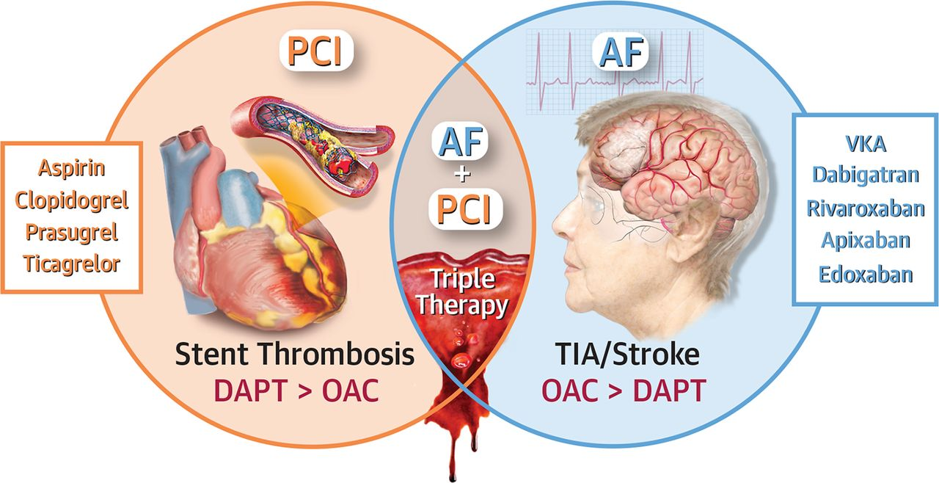
Triple Antithrombotic Therapy at the Intercept Between Threats and Opportunities
DOAC > VKA + P2Y₁₂ inhibitor
+ very short duration of ASA (in most patients)
Capodanno D & Angiolillo DJ. JACC Cardiovasc Interv 2017; 10:1366-69.
Notes:
Speaker Notes:

Slide 29

Key Messages
Patients with AF and CAD who qualify for OAC based on CHADS-65:
With stable CAD can stop ASA and be treated with a DOAC alone.
Post elective PCI should be treated with clopidogrel + a DOAC for 1 to 12 months (depending on type of stent etc), then a DOAC alone
Recent ACS with PCI:
Initial period of “triple therapy” with ASA of 1 day to 6 months
Then clopidogrel + a DOAC for up to 12 months (total from ACS)
Then a DOAC alone.
Notes:
Speaker Notes:
Most patients with AF and CAD who are eligible for OAC according to CHADS-65 end up on a DOAC alone after 12 months of CAD “stability”, defined as no ACS or need for revascularization (PCI or CABG).

Slide 30
Backup Slides

Slide 31
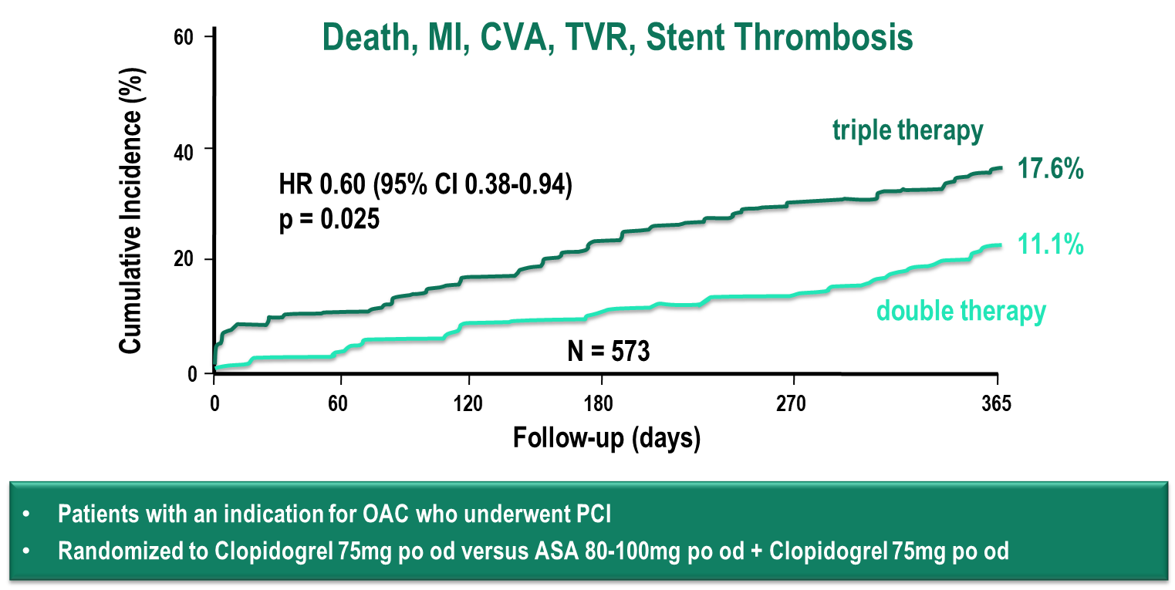
The WOEST Study: Cumulative Risk of Secondary Endpoint with Combination Antithrombotic
Lancet 2013; 381: 1107-15.
Notes:
Speaker Notes:

Slide 32
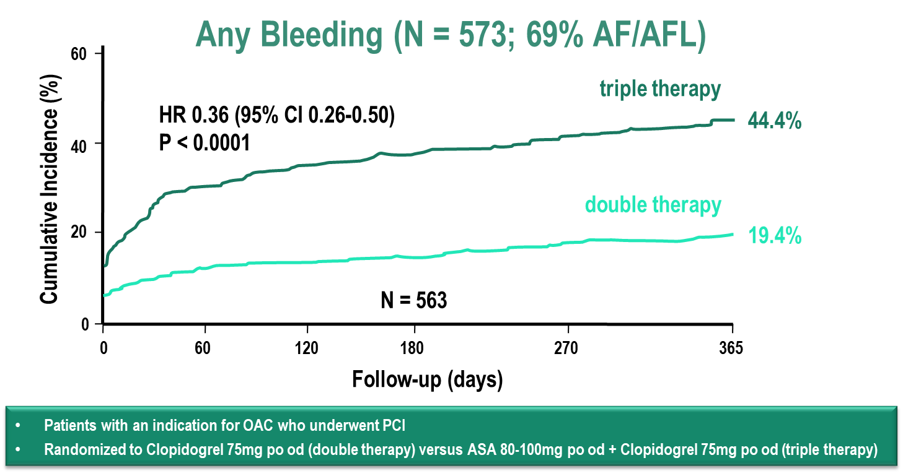
The WOEST Study: Risk of Bleeding with Combination Antithrombotic
Lancet 2013; 381: 1107-15.
Notes:
Speaker Notes:

Slide 33
Clinical Trials with DOACs and Newer P2Y12 Antiplatelets in Various Combinations
TRIAL | Projected Completion
PIONEER (rivaroxaban) | Nov. 2016 (AHA)
REDUAL-PCI (dabigatran) | Aug 2017 (ESC)
AUGUSTUS (apixaban) | Dec 2018
Notes:
Speaker Notes:
Three trials, Re-Dual, Pioneer and Augustus are under way and evaluating different combination strategies of SAPT (no ASA), DAPT (including the newer P2Y12 antiplatelets) with Warfarin or a DOAC. The major endpoints tested are major bleeding and clinically significant non-major bleeding (i.e. safety). Secondary endpoints include ischemic events (MI, stroke, stent thrombosis etc). The Augustus study algorithm is presented as an example of the complexity of these trials and the many different options available. Until the results of these trials are available, clinical judgment and an individualized strategy balancing ischemic v.s. bleeding risk is required.

Slide 34
PIONEER AF-PCI
An OPen-label, Randomized, Controlled, Multicenter Study ExplorIng TwO TreatmeNt StratEgiEs of Rivaroxaban and a Dose-Adjusted Oral Vitamin K Antagonist Treatment Strategy in Subjects With Atrial Fibrillation Who Undergo Percutaneous Coronary Intervention PIONEER AF-PCI
C. Michael Gibson, MS, MD on behalf of the PIONEER Investigators
Notes:
Speaker Notes:

Slide 35
Rivaroxaban in Patients With AF Undergoing PCI:
PIONEER AF-PCI
End of treatment at 12 months
R
A
N
D
O
M
I
Z
E
Riva 15 mg qd* Clopidogrel 75 mg qd†
Patient Population
2100 patients with NVAF
Open label
No prior stroke/TIA
PCI with stent placement
WOEST like
≤72 hours
After
Sheath
removal
1,6, or 12 months
Riva 2.5 mg bid Clopidogrel 75 mg qd†
Aspirin 75-100 mg qd‡
Riva 15mg QD
Aspirin 75-100 mg qd
ATLAS like
1,6, or 12 months
VKA (tar INR 2.0-2.5/3.0) Clopidogrel 75 mg qd†
Aspirin 75-100 mg qd
VKA (target INR 2.0-3.0) Aspirin 75-100 mg qd
Triple
therapy
Primary objective: clinically significant bleeding at 12 months
Secondary objectives: CV death, MI, stroke, and stent thrombosis
*XARELTO® dosed at 10 mg once daily in patients with CrCl of 30 to <50 mL/min.
†Alternative P2Y₁₂ inhibitors: 10 mg once-daily prasugrel or 90 mg twice-daily ticagrelor.
‡Low-dose aspirin (75-100 mg/d).
Data on File. Janssen Pharmaceuticals, Inc.
http://clinicaltrials.gov/show/NCT01830543 Oct 2015
Notes:
Speaker Notes:

Slide 36
Clinically Significant Bleeding
PIONEER AF-PCI
HR Values vs Group 3
HR = 0.59
(0.47, 0.76)
P < .001
HR = 0.63
(0.50, 0.80)
P < .001
Patients (%)
Riva 2.5 mg BID + DAPT,
then Riva 15 mg OD + aspirin
VKA + DAPT
then VKA
+ aspirin
Riva 15 mg OD + single AP
N = 709
N = 709
N = 706
Gibson CM, et al .N Engl J Med. 2016.22;375:2423-2434
Notes:
Speaker Notes:
Patients in both rivaroxaban arms had significantly reduced bleeding events vs patients in the triple-therapy arm

Slide 37
MACE
PIONEER AF-PCI
Riva 15 mg OD + single AP
Riva 2.5 mg BID + DAPT,
then Riva 15 mg OD + aspirin
VKA + DAPT
then VKA
+ aspirin
Patients (%)
N = 694
N = 704
N = 695
Gibson CM, et al .N Engl J Med. 2016.22;375:2423-2434
Notes:
Speaker Notes:
No difference in efficacy rates between the 3 arms

Slide 38
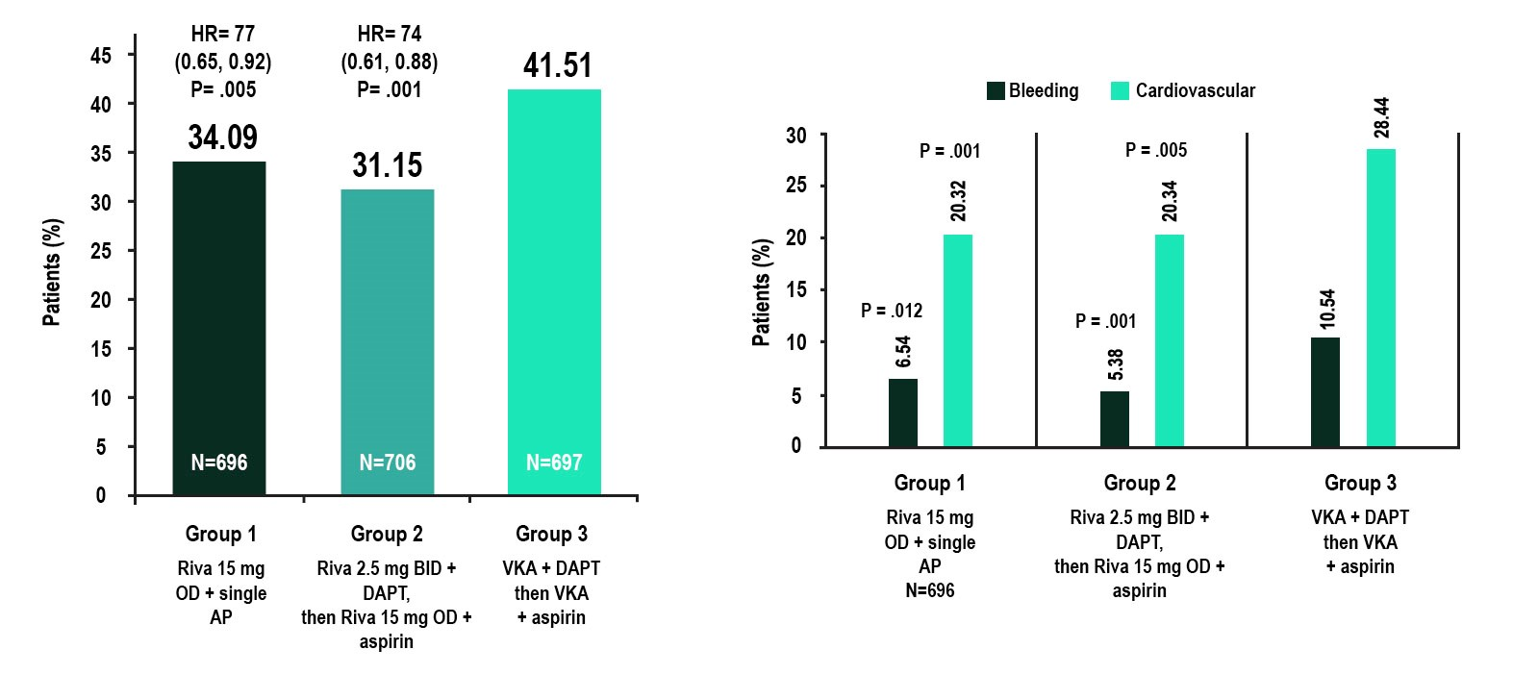
Post Hoc Analysis Recurrent Hospitalization
PIONEER AF-PCI
Gibson CM, et al .N Engl J Med. 2016.22;375:2423-2434
Notes:
Speaker Notes:
Patients in both rivaroxaban arms had a significantly reduced risk for recurrent all-cause hospitalization
Significant reductions seen in both bleeding-related and cardiovascular (CV)-related rehospitalization

Slide 39
Conclusion
PIONEER AF-PCI
Among stented AF participants, administration of either rivaroxaban 15 mg daily plus P2Y12 monotherapy for one year or rivaroxaban 2.5 mg BID plus 1, 6, or 12 months of DAPT reduced the risk of clinically significant bleeding as compared with standard of care VKA plus 1, 6, or 12 months of DAPT and yielded comparable efficacy with broad confidence intervals
Notes:
Speaker Notes:

Slide 40
Conclusion
PIONEER AF-PCI
In patients with AF who have undergone PCI:
Dual therapy with dabigatran and a P2Y12 antagonist significantly reduced the
risk of bleeding versus warfarin triple therapy , with non-inferiority for overall
thromboembolic events
Absolute risk reductions with dabigatran dual therapy were 11.5% and 5.5% in
ISTH major or clinically relevant non-major bleeding at the 110 mg and
150 mg doses, respectively, compared with warfarin triple therapy
These dabigatran dual therapy regimens, using doses approved worldwide for stroke
prevention, offer clinicians two additional options for managing Afib patients post-PCI
Notes:
Speaker Notes:

Slide 41
RE-DUAL PCI
RE-DUAL PCI: dual antithrombotic therapy
with dabigatran after percutaneous coronary
intervention in patients with atrial fibrillation
Christopher P. Cannon
Deepak L Bhatt, Jonas Oldgren, Gregory YH Lip, Stephen G Ellis, Takeshi Kimura, Michael Maeng,
Bela Merkely, Uwe Zeymer, Savion Gropper, Matias Nordaby, Eva Kleine, Ruth Harper, Jenny
Manassie, James L Januzzi, Jurrien M ten Berg, Philippe Gabriel Steg and Stefan H Hohnloser
On behalf of the steering committee and RE-DUAL PCI investigators
Notes:
Speaker Notes:

Slide 42
Study Design: Multicenter, randomized,
open-label trial following a PROBE design
RE-DUAL PCI
Dabigatran 150 mg BID + P2Y12 inhibitor
Mean Duration of Follow-Up:
~14 months
Patients
with AF undergoing
PCI with stenting
Dabigatran 110 mg BID + P2Y12 inhibitor
R
Randomization
≤ 120 hours
post-PCI*
Warfarin (INR 2.0–3.0) + P2Y12 inhibitor + ASA
N=2725
6-month minimum treatment duration with visits every 3 months for the first year, then visits and telephone contact alternating every 3 months and a 1-month post-treatment visit
Dabigatran (110 or 150 mg)
P2Y12 inhibitor
Warfarim
P2Y12 inhibitor
1 month of ASA (BMS)
3 months of ASA (DES)
Study drug should be administered 6 hours after sheath removal and no later than ≤ 120 hrs post-PCI ( ≤ 72 hrs is preferable). PROBE, prospective, randomized, open, blinded end-point;
R, randomization; BMS, bare metal stent; DES, drug-eluting stent. ClinicalTrials.gov: NCT02164864; Cannon et al. Clin Cardiol 2016
Notes:
Speaker Notes:

Slide 43
RE-DUAL PCI
Patients were randomized based on age group and location
Dabigatran 150 mg dual therapy
n=763
Patients aged <80 years worldwide (<70 years in Japan), and patients
aged ≥ 80 years in the USA
Dabigatran 110 mg dual therapy
n=769
Warfarin triple therapy
n=766
Dabigatran 110 mg dual therapy
Patients aged ≥ 80 years outside the USA ( ≥ 70 years in Japan)
n=212
Warfarin triple therapy
n=215
ClinicalTrials.gov: NCT02164864; Cannon et al. Clin Cardiol 2016
Notes:
Speaker Notes:

Slide 44
RE-DUAL PCI
Inclusion and exclusion criteria
Key inclusion criteria
Key exclusion criteria
Patients aged ≥ 18 years with paroxysmal, persistent or permanent NVAF
ACS successfully treated by PCI and stenting (BMS or DES)
Stable CAD with ≥ 1 lesion eligible for PCI that was successfully treated by elective PCI and stenting (BMS or DES)
Cardiogenic shock during current hospitalization
Use of fibrinolytics within 24 hrs of randomization that, in the investigator ’s opinion, will put patient at high risk of bleeding
Stroke or major bleeding event within 1 month prior to screening visit
Severe renal impairment (CrCl <30mL/min)
ClinicalTrials.gov: NCT02164864; Cannon et al. Clin Cardiol 2016
Notes:
Speaker Notes:

Slide 45
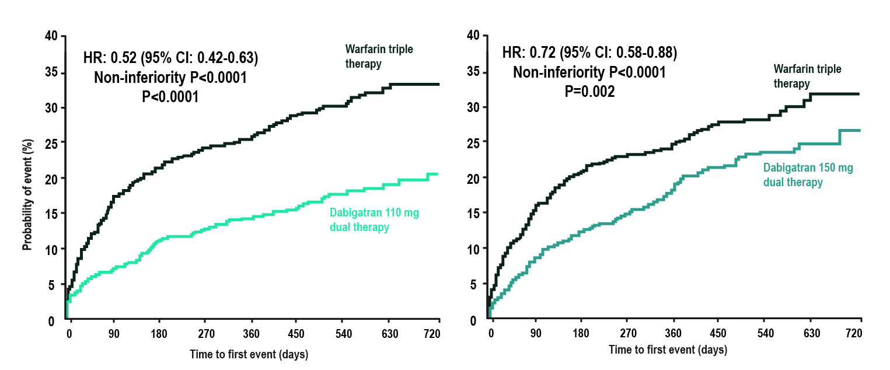
RE-DUAL PCI
Primary Endpoint:
Time to first ISTH major or clinically relevant non-major bleeding event
ClinicalTrials.gov: NCT02164864; Cannon et al. Clin Cardiol 2016
Notes:
Speaker Notes:

Slide 46
RE-DUAL PCI
Time to death or thromboembolic event, or unplanned revascularization
20
18
16
35
30
HR: 1.04 (95% CI: 0.84–1.29)
Non-inferiority P=0.0047
Dabigatran (combined doses) dual therapy
14
12
10
8
6
4
2
13.7%
25
20
15
10
5
13.4%
Patients with outcome event (%)
Probability of event (%)
Warfarin Triple Therapy
0
0
Dabigatran
(combined dose) dual therapy
(n=1744)
Warfarin
Triple Therapy
(n=981)
0
90
180
270
360
450
540
630
720
Time to first event (days)
Non-inferiority P value is one sided (alpha=0.025). Results presented are Step 3 of hierarchical testing procedure, testing non-inferiority of dabigatran dual therapy (combined doses) to warfarin triple therapy in death or thromboembolic event and unplanned revascularization
ClinicalTrials.gov: NCT02164864; Cannon et al. Clin Cardiol 2016
Notes:
Speaker Notes:

